Slide 1

Turtle Shelter Project
Team 3-6
Notes:
Porter

Slide 2

Notes:
Porter

Slide 3
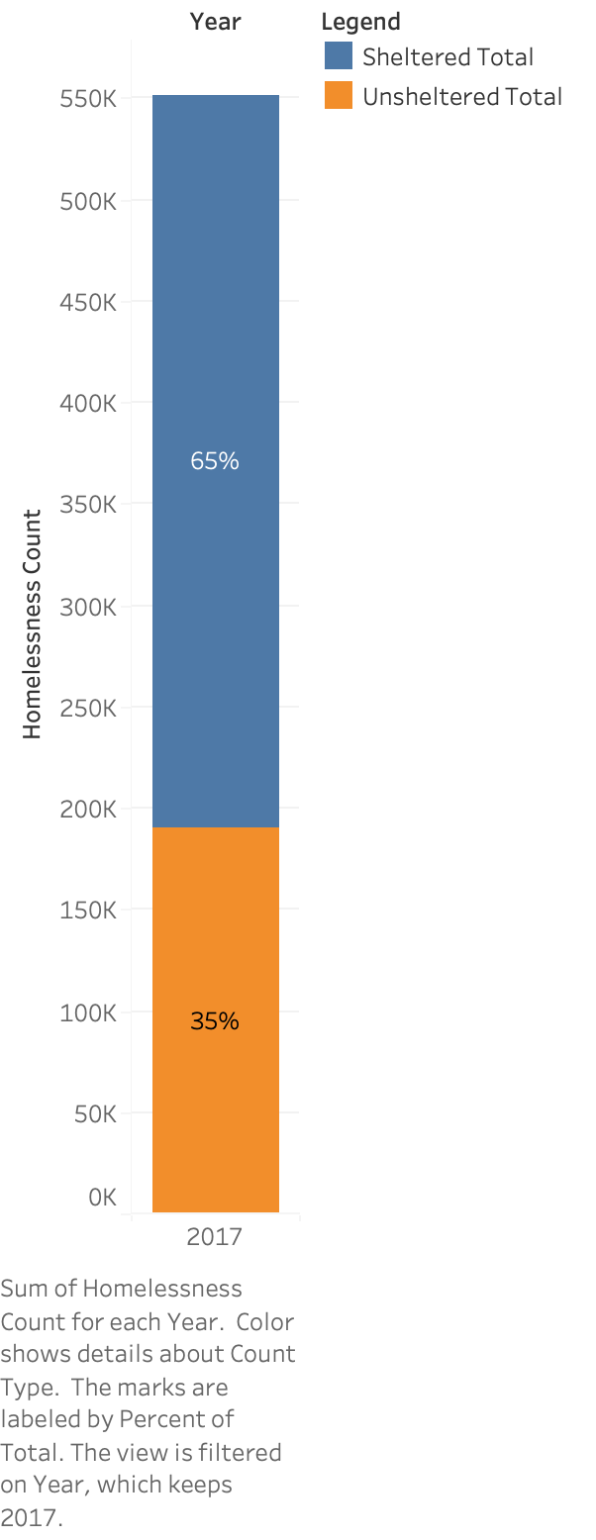
US Homeless Population
Notes:
Davis

Slide 4
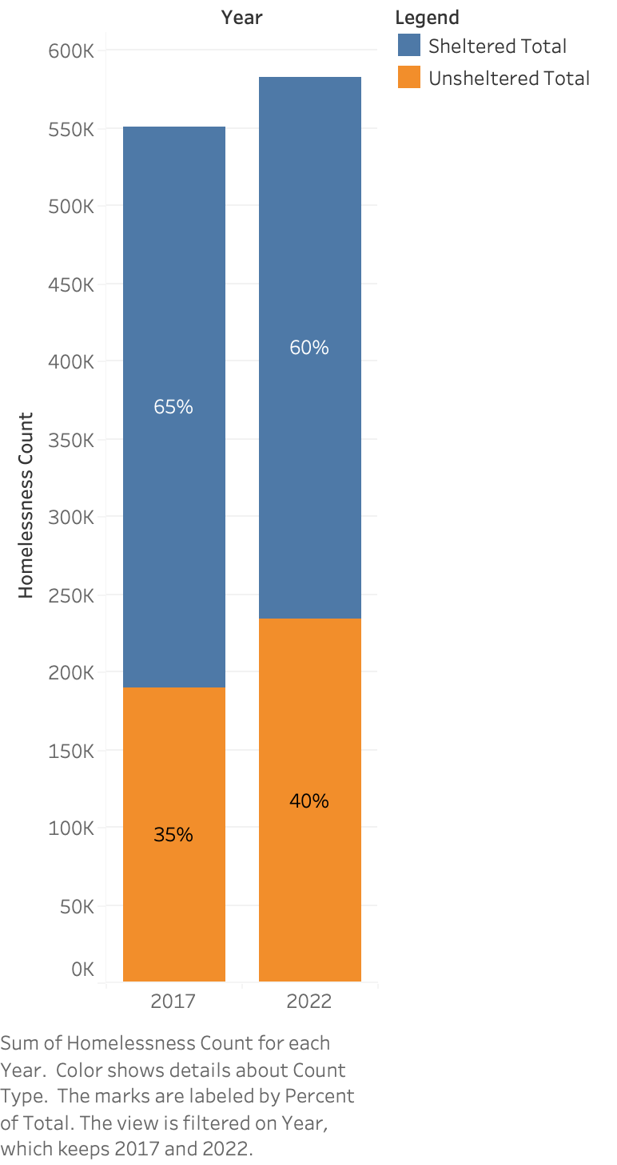
US Homeless Population
5% Increase of Unsheltered Homeless Population Between 2017 and 2022
Notes:
Davis

Slide 5
What About the States Where TSP Already Operates?
Notes:
Addy

Slide 6
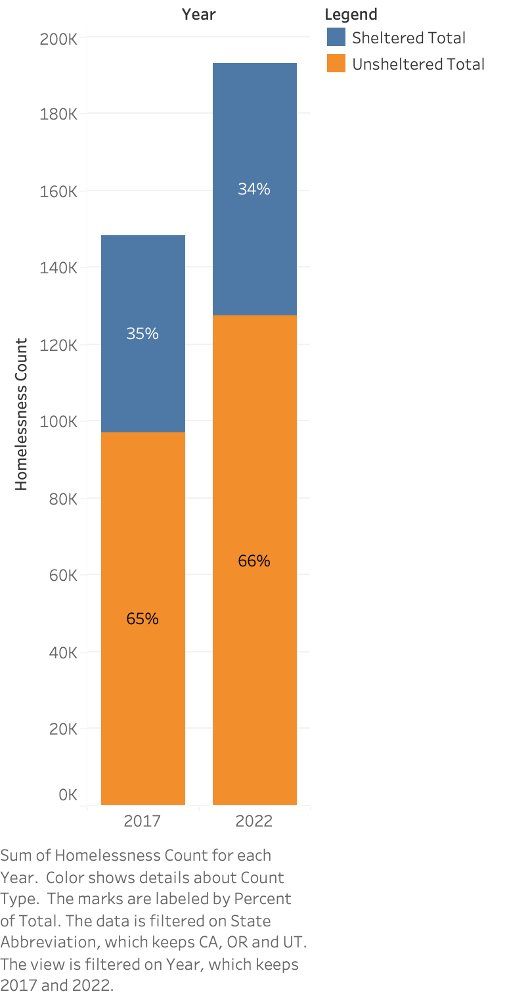
CA, OR, UT Homeless Population
30% More Unsheltered Homeless Than Sheltered Homeless In TSP Chapters
Notes:
Addy

Slide 7
Breakdown Between States
Notes:
Caleb

Slide 8
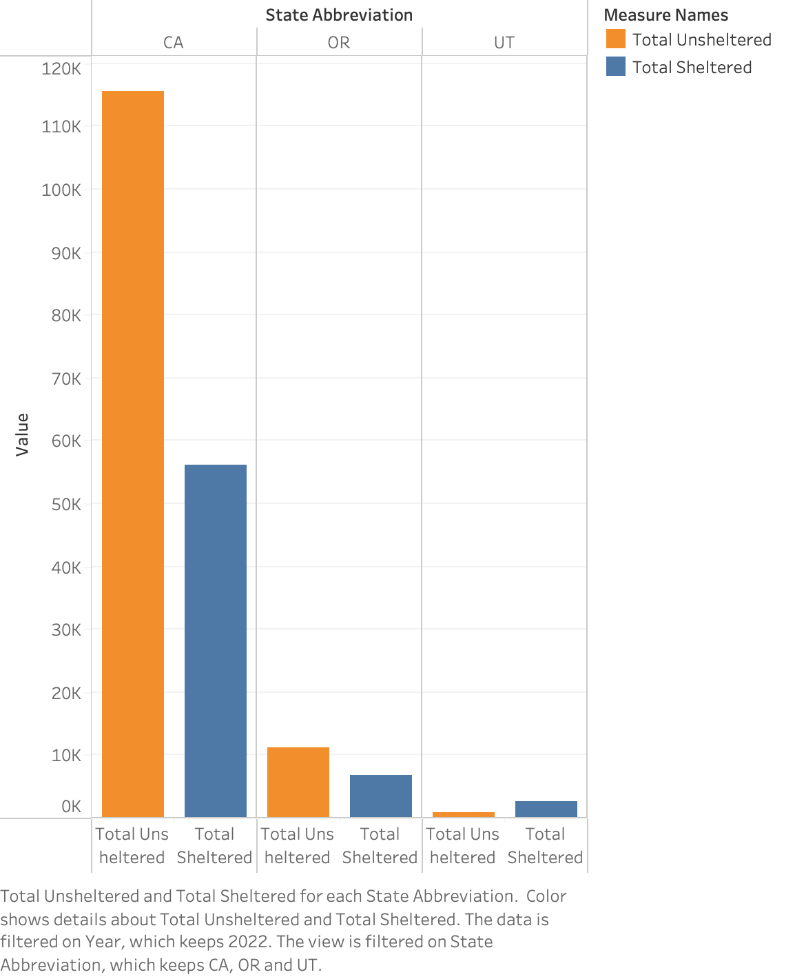
Comparison Between CA, OR, and UT in 2022
Notes:
Caleb

Slide 9
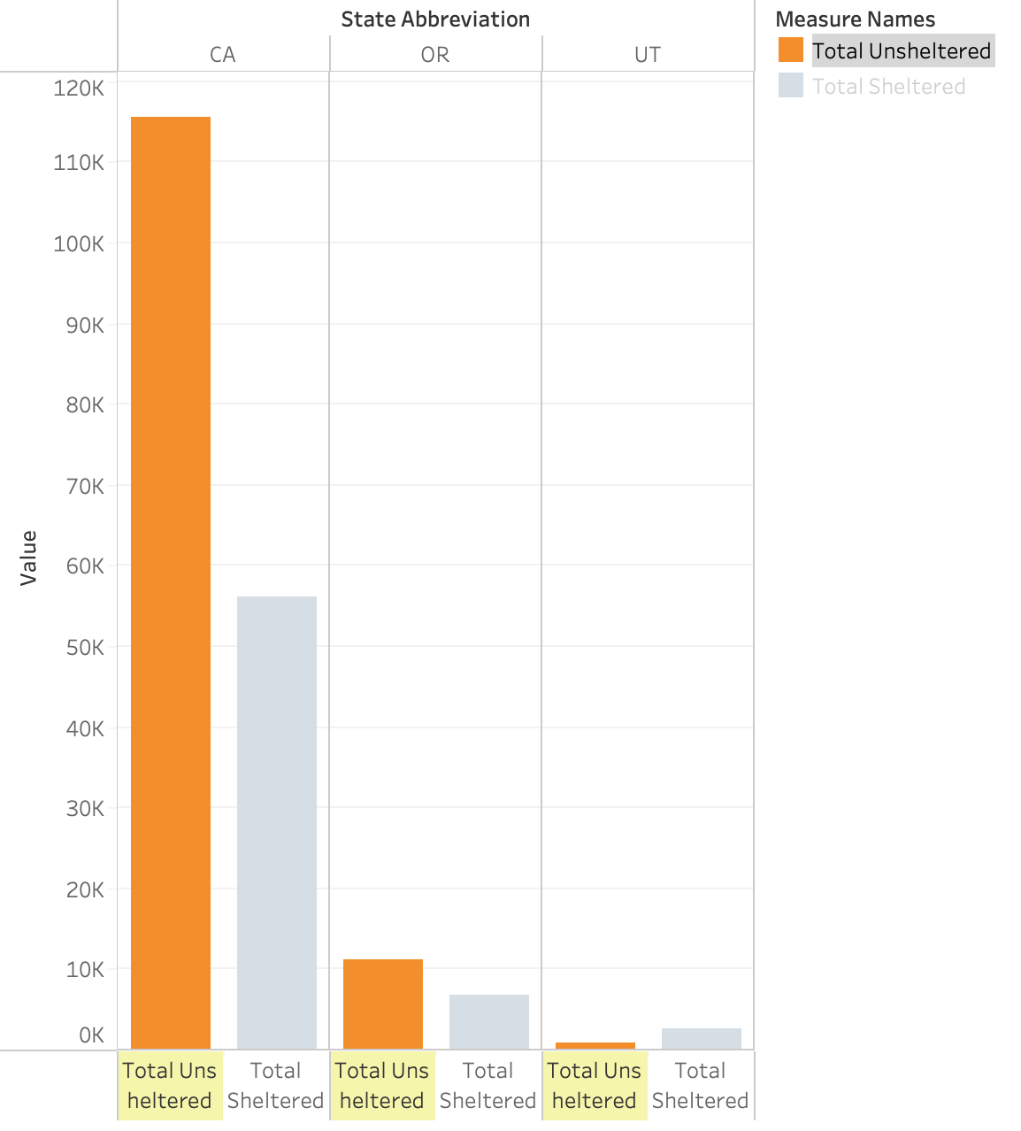
Comparison Between CA, OR, and UT in 2022
115,491 Unsheltered Homeless in California
Notes:
Caleb

Slide 10

Comparison Between CA, OR, and UT in 2022
5,900 Turtle Shelter Project Vests Distributed to Date
Notes:
Porter

Slide 11
We Recommend TSP Directs Itself Towards California
Notes:
Porter

Slide 12
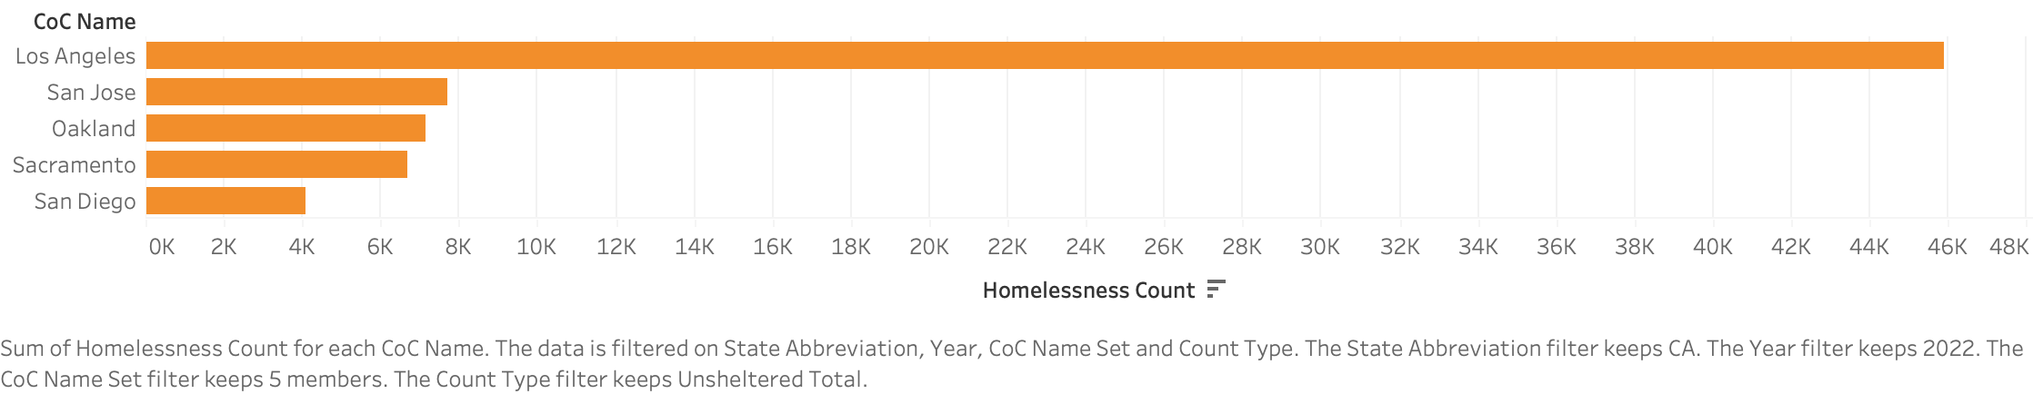
Top 5 Unsheltered Homeless Populations in California
Notes:
Porter

Slide 13
Free Tools Already Available
Former Event Contacts
Current Sponsors
Just Serve
Our New Website
Notes:
Addy

Slide 14
How Does the Website Benefit Our Organization? How Does the Website Benefit Regular Visitors?
turtleshelterproject.team36.org
Notes:
Addy

Slide 15
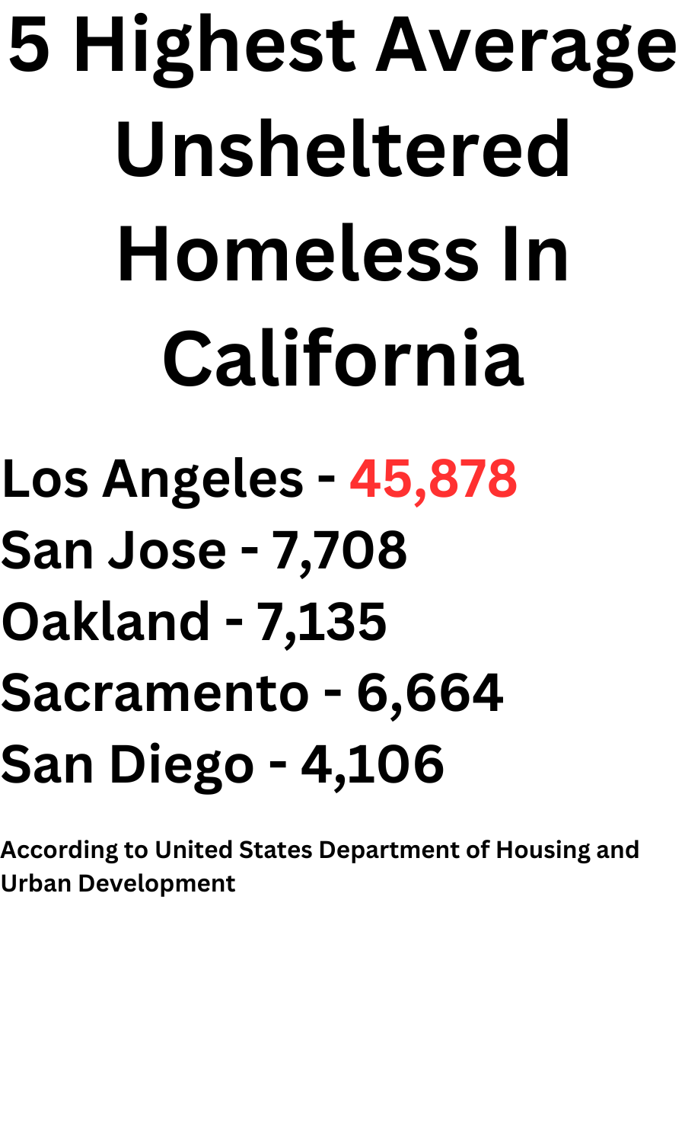
Where to Focus Our Efforts

